Slide 1

StarCraft Pro Scout
Torin Rettig

Slide 2

Concept: Predict the Pros
Predict the next batch of StarCraft
Pro players with machine learning

Slide 3
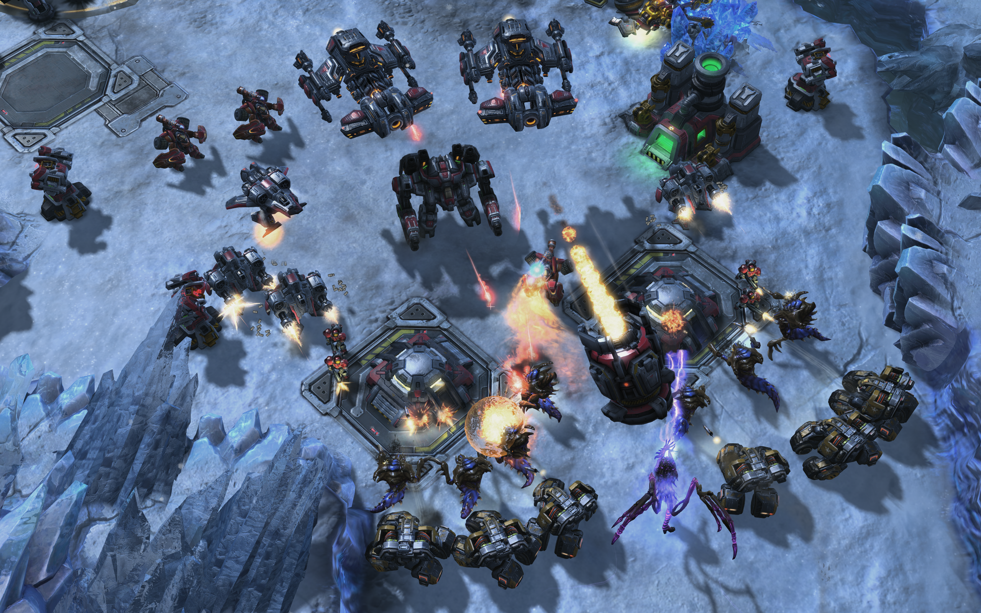
What is StarCraft?
Real-Time Strategy game
Gain resources
Build an army
Destroy your opponent’s base
The original eSport

Slide 4
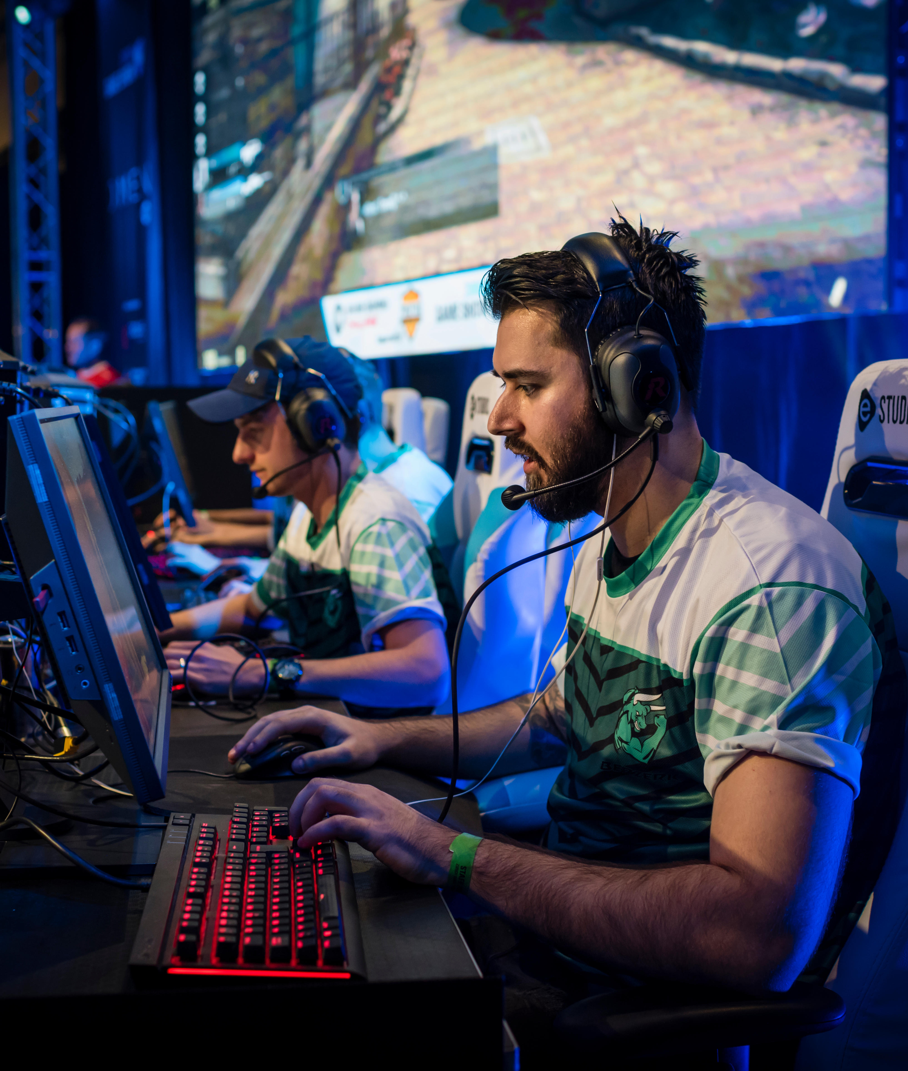
Motivation
eSports is a multimillion dollar industry
Tremendous growth over the past decade
Talented players are a hot commodity
ID the next star before the competition
Notes:
Esports is a multi-million dollar industry
From LAN tournaments in basements to arenas with thousands of spectators and multi-million dollar prize puts
If teams can identify potential pro players early in their career they can get them for more favorable contacts and body the strength of their teams before the competition.
Finding winning skills in StarCraft can potentially extend to other similar games like League of Legends and DotA 2
The methodology could potentially extend to quit different games like Overwatch and CS:GO

Slide 5

Data
2013 SC2 Replay Analysis study (Simon Fraser University)
3395 observations of player game replays
19 variables: int/float
Variable Sample
Actions Per Minute
Hour Played Per Week
Complex Units Created
Perception Action Cycles
Unique Units Created
Map Explored
Notes:
Aggregated screen movements into screen-fixations using a Salvucci & Goldberg (2000) dispersion-threshold algorithm, and defined Perception Action Cycles (PACs) as fixations with at least one action.
Real-time second is equivalent to roughly 88.5 timestamps.
Ordinal prediction of League
All other data is numerical (integer & float)

Slide 6

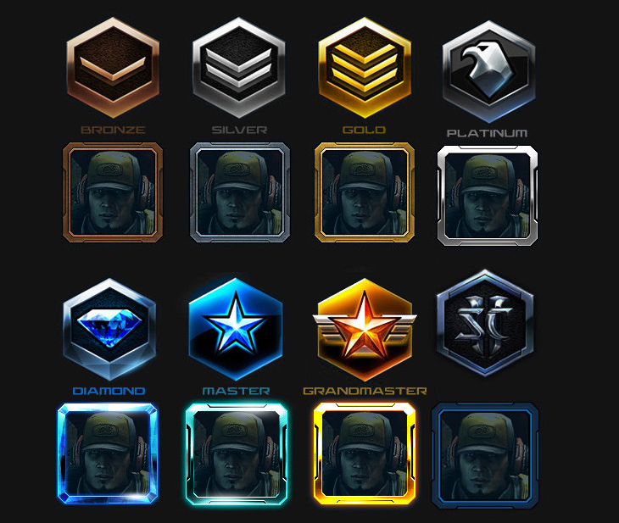
Methodology
Target: Player League Ranking
Use ML classification to predict League Ranking
Use both parametric and non-parametric modeling
StarCraft Leagues
PRO
Notes:
Aggregated screen movements into screen-fixations using a Salvucci & Goldberg (2000) dispersion-threshold algorithm, and defined Perception Action Cycles (PACs) as fixations with at least one action.
Real-time second is equivalent to roughly 88.5 timestamps.
Ordinal prediction of League
All other data is numerical (integer & float)

Slide 7
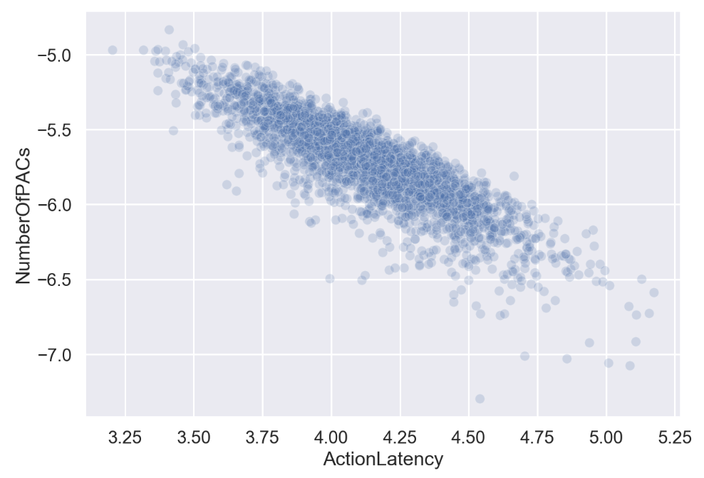
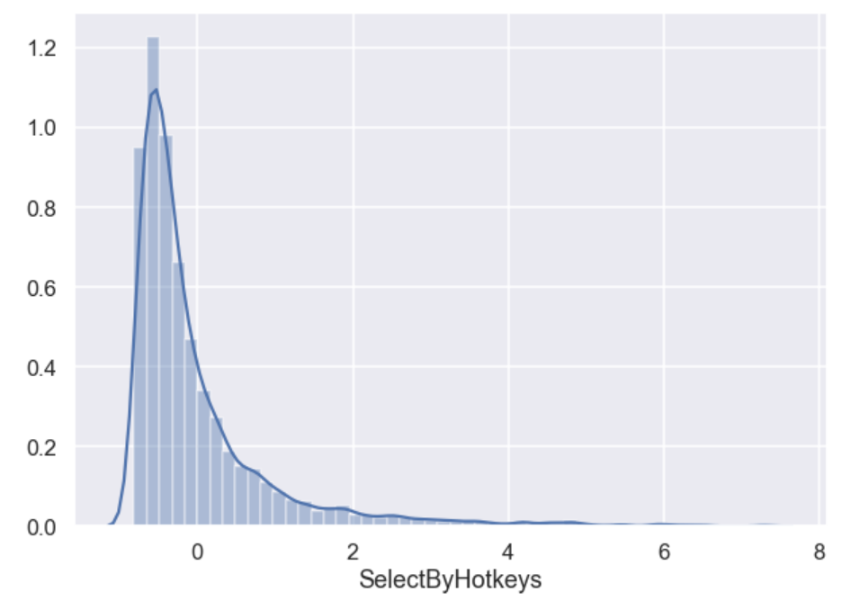
Feature Selection
Significant collinearity & normality issues
Created parametric & non-parametric data sets
Notes:
Collinearity categories were not terribly surprising
Many variables were heavily skewed, generally to the right, making them tough to use in parametric models

Slide 8





Compress Categories
8 Leagues
3 Categories
Amateur
Promising
PRO
Contender
PRO
Fewer categories for increased relevance per category
Notes:
Initial predictions were pretty bad ~0.40 accuracy
Later leagues had little representation
There are better logical categories for what we’re looking for

Slide 9

Modeling
Overall goal is to maximize Recall
Contender was top priority
KNN, SVC, Random Forests, Logistic Regression
Oversampling made a big difference
Contender
PRO
Notes:
Aggregated screen movements into screen-fixations using a Salvucci & Goldberg (2000) dispersion-threshold algorithm, and defined Perception Action Cycles (PACs) as fixations with at least one action.
Real-time second is equivalent to roughly 88.5 timestamps.
Ordinal prediction of League
All other data is numerical (integer & float)

Slide 10
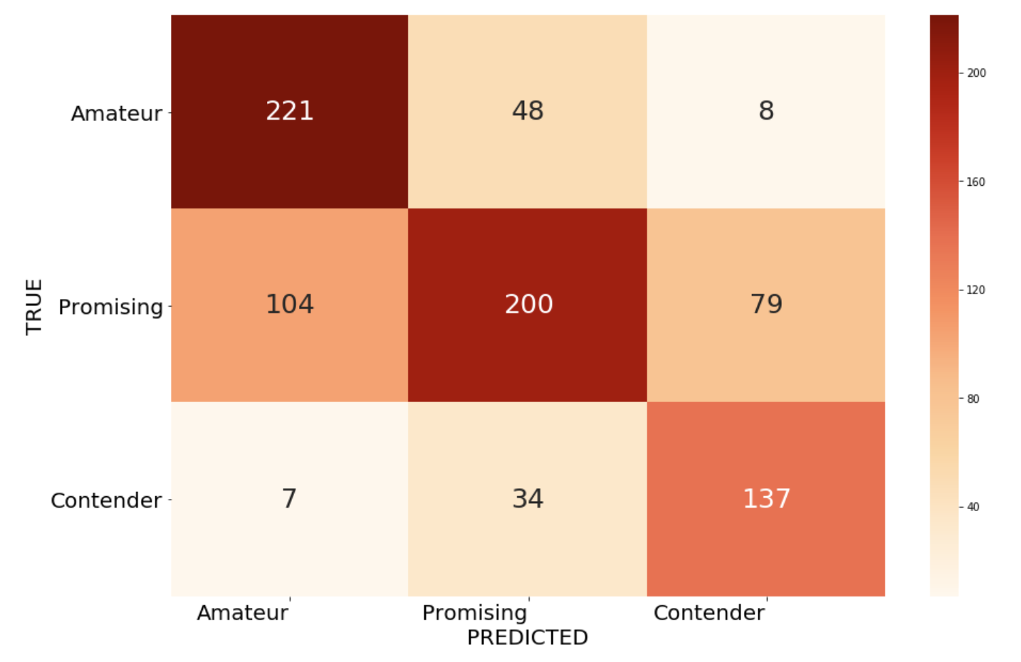
Modeling – Performance
Modeling Scores
SVC Linear Kernel
Confusion Matrix
Model | Contender Recall | Accuracy
KNN-CV | 0.7670 | 0.6337
SVC Linear Kernel | 0.7697 | 0.6646
Random Forest | 0.4775 | 0.6480
Logistic Regression | 0.8862 | 0.4678
Notes:
Aggregated screen movements into screen-fixations using a Salvucci & Goldberg (2000) dispersion-threshold algorithm, and defined Perception Action Cycles (PACs) as fixations with at least one action.
Real-time second is equivalent to roughly 88.5 timestamps.
Ordinal prediction of League
All other data is numerical (integer & float)

Slide 11
Conclusions
Can we predict the next SC pro player? Yes, with caveats
There is high variability in player performance metrics requiring significant work
Oversampling significantly improved recall performance across the board
Performance is generally good, but can be improved
Notes:
Aggregated screen movements into screen-fixations using a Salvucci & Goldberg (2000) dispersion-threshold algorithm, and defined Perception Action Cycles (PACs) as fixations with at least one action.
Real-time second is equivalent to roughly 88.5 timestamps.
Ordinal prediction of League
All other data is numerical (integer & float)

Slide 12

Thank You!

Slide 13
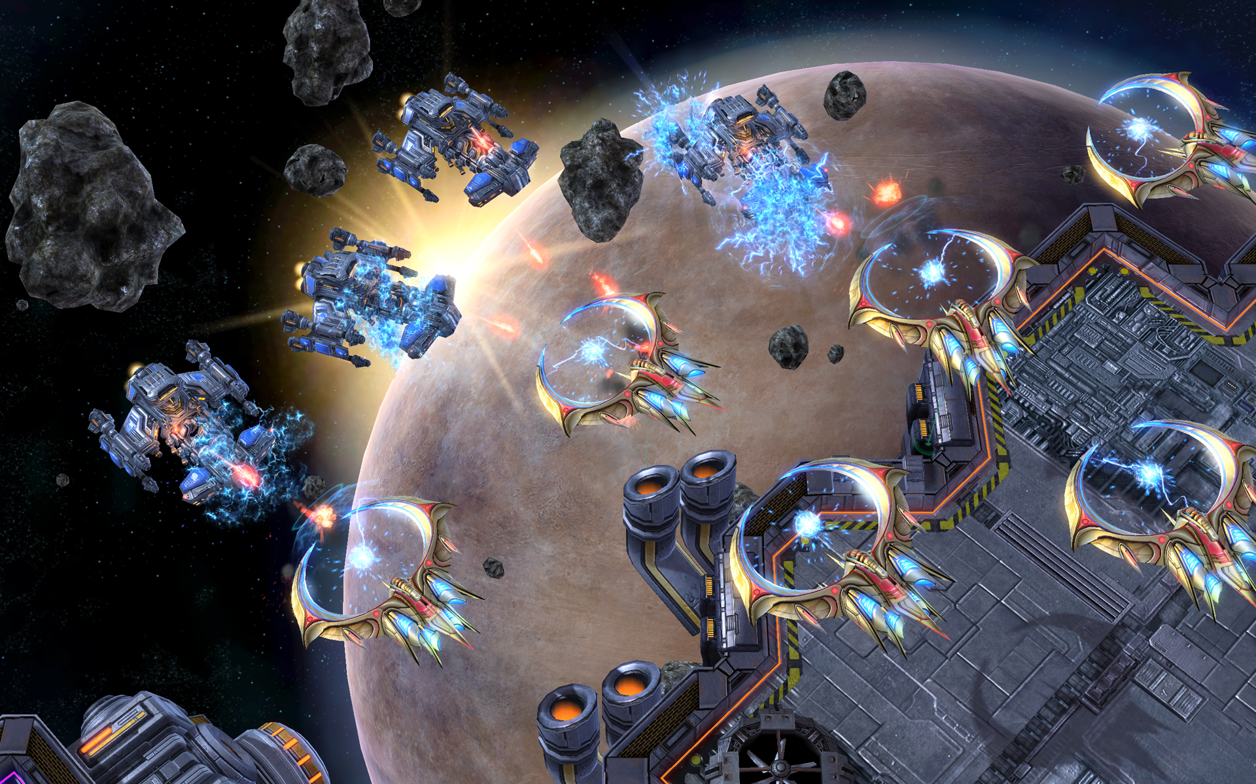
Future Work
Spend more time with feature engineering for parametric approaches
Try to get a larger sample size, especially for smaller categories
Apply these approaches to other competitive games
Notes:
Aggregated screen movements into screen-fixations using a Salvucci & Goldberg (2000) dispersion-threshold algorithm, and defined Perception Action Cycles (PACs) as fixations with at least one action.
Real-time second is equivalent to roughly 88.5 timestamps.
Ordinal prediction of League
All other data is numerical (integer & float)

Slide 14

Appendix

Slide 15

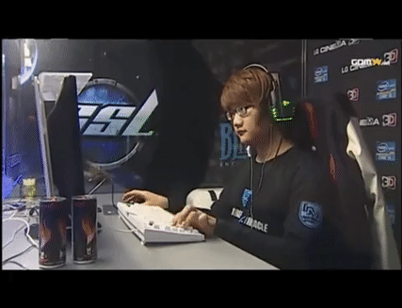
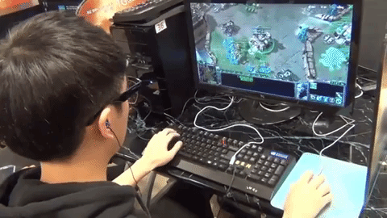
APM & PACs
APM
PACs
Notes:
Aggregated screen movements into screen-fixations using a Salvucci & Goldberg (2000) dispersion-threshold algorithm, and defined Perception Action Cycles (PACs) as fixations with at least one action.
Real-time second is equivalent to roughly 88.5 timestamps.
Ordinal prediction of League
All other data is numerical (integer & float)

Slide 16
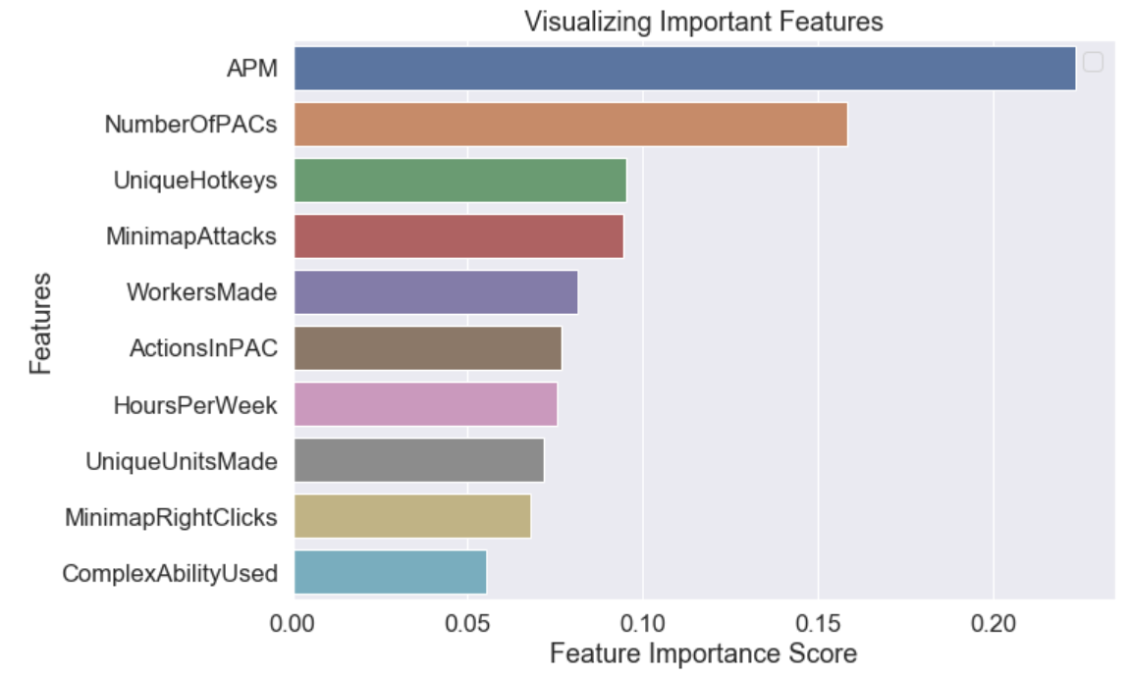
Modeling – Feature Importance
Unsurprisingly both APM and PACs were the most important indicators of League placement
Notes:
Aggregated screen movements into screen-fixations using a Salvucci & Goldberg (2000) dispersion-threshold algorithm, and defined Perception Action Cycles (PACs) as fixations with at least one action.
Real-time second is equivalent to roughly 88.5 timestamps.
Ordinal prediction of League
All other data is numerical (integer & float)

